Slide 1
2021 MLP team meeting 04.07
Yonsei University
Machine Learning Project Team 09

Slide 2
Proposal – Item classification
Items classification along the..
Existing papers didn’t mention the classification of items
Frequency, Similarity, Importance 등을 기준으로 Classification (or Clustering)
Find optimal arrangement
Using Classification algorithm with proper weight (like 유투브, 넷플릭스 추천시스템)
Store on a Pod based on Classification
Arrange Pods in Inventory Area based on Frequency
Dependency
Ex) Korean food such as 보쌈
Includes meats, vegetables etc.
We can make them arrange together
Find the specific dataset from Kaggle or somewhere
Future Work
Paper Research
Algorithm application method
Find Dataset

Slide 3

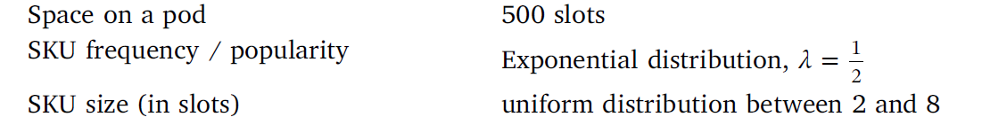
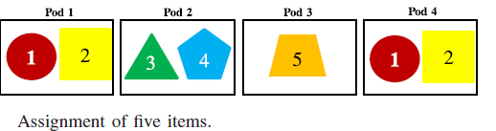
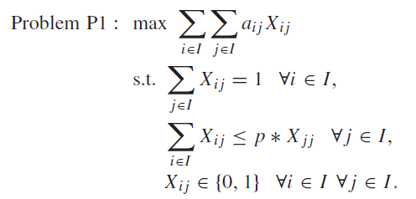
Proposal – Item classification
Existing Papers
“Decision rules for robotic mobile fulfillment systems” , M.Merschformann,…
Set in the Orders tap
Set SKU size, item distribution, Order distribution
Uniform distribution, SKU size is 2~8 items in this paper
Item Classification is distributed in pods according the set distribution, but not applicated in a pod
“Item Assignment Problem in a Robotic Mobile Fullfillment System”, Hyun-Jung Kim..
5 Items, 4 Groups, one item in one Group
Calculate Similarity from Frequency (Clustering)
Maximize the Sum of similarity values
Optimization Algorithm : Heuristic Algorithm ( to revise the varied similarity)

Slide 4
Proposal – Item classification
적용 방안
Pod 내 분류
RAWSimO 내에 distribution 코드 수정
설정된 Distribution으로 배정 → Clustering model
Frequency 뿐만 아니라 다른 input 값을 통해 similarity 계산하여 Clustering model 학습
Similarity Pair 3개 이상 가능하도록 적용
Pod의 위치 분류
RAWSimO : Random, Fixed, Nearest, Station-based, Class 총 5가지
Pick order, Replenishment order에 따른 Pod의 storage Assignment decision rule modeling
PSA 내부에 Decision rule 추가

